Slide 1

Ad-din Sakina Women’s Medical College Hospital
(Department of Ophthalmology)

Slide 2
Basic Information
Started on 2003 as Mobile eye Care Project
In 2005 established Base Hospital
Upgraded to Ophthalmology Department of Ad-din Sakina Women’s Medical College in 2012

Slide 3
Organogram
Professor | Associate Professor | Assistant Professor
Dr. Gias Uddin
Dr. Nahid Kamal
Dr. Minhajur Rahman
RS | Registrar | Assistant Registrar

Slide 4
Nurses and Other Staffs
Matron (1)
Nursing Supervisor (3)
Senior Staff Nurse (10)
Assistant Nurse (5)
Medical Assistant (3)
Counselor (1)
Refractionist (1)
Pharmasist (1)
Data entry Operator (1)
Others (20)

Slide 5
Activities
Teaching Service
Outdoor service
Indoor Service
Outreach Service

Slide 6
Academic activities
Under graduate level
Intern’s Doctor’s Training : Morning Session, Case Presentation, Monthly Meeting , Discursion on referred case, Teaching according to log book.
5th year MBBS Class
4th year MBBS Class
3rd year MBBS Class
Nursing Training
Ongoing Research study :
  Wound infection

Slide 7
Outdoor service
Reception and Registration
Checkup- by Professor or Medical officer
Refraction
Minor Operation
Pathology service
Optical Shop and Pharmacy service

Slide 8
Indoor Service
Word service- Aseptic and Septic
OT Service- Aseptic and Septic
Operations,
Cataract- Phaco and SICS
DCR, DCT
Glaucoma Operation
Pterygium Operation
ROP Screening

Slide 9
Outreach Service
OPD at field level
Cataract patient screening and examination
Cataract Operation by MOT
Providing refraction service
Free spectacles distribution
Carrying free cataract patient to base hospital by Bus
Refer others patient to base hospital

Slide 10
Performance of Ophthalmology Department
Year | OPD | Cataract Operation |  |  | Others Operation
 |  | SICS | Phaco | Total
2003 | 1676 | 408 | 0 | 408 | -
2005 | 8873 | 2160 | 0 | 2160 | -
2010 | 14379 | 3500 | 0 | 3500 | -
2015 | 37141 | 8650 | 0 | 8650 | -
2018 | 56694 | 12150 | 836 | 12986 | 1399
2019 | 59501 | 15319 | 955 | 16274 | 1389
2020 | 40296 | 6207 | 705 | 6912 | 848
2021(Jan-Nov) | - | 7195 | 757 | 7952 | 814

Slide 11
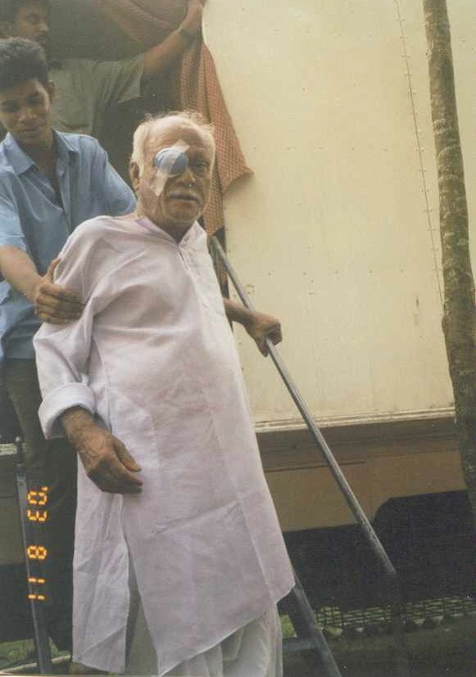
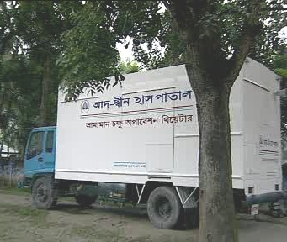
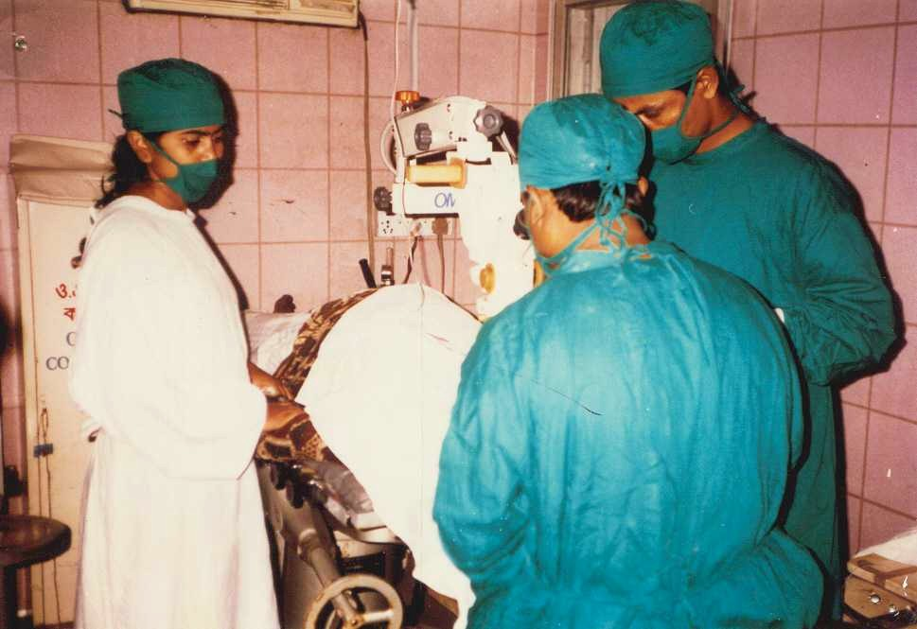
Eye Care Project

Slide 12
Annual Trend of Eye Care Project(OPD)

Slide 13
Annual Trend of Eye Care Cataract

Slide 14

Thank You All

